Slide 1

Thirumalasetty Luhith Paul
Final project

Slide 2

KEYLOGGER
A Keylogger is a type of surveillance software or hardware that is designed to record every keystroke typed on a computer or mobile device. Keyloggers can be either software-based or hardware-based.
Software Keyloggers: These are programs that are installed on a computer without the user's knowledge. The software keylogger runs in the background, capturing keystrokes and sometimes other activities such as screenshots or clipboard content.
Hardware Keyloggers: These are physical devices that are inserted between the keyboard and the computer. Hardware keyloggers are more difficult to detect than software keyloggers because they do not rely on software installation. They simply intercept and record keystrokes as they pass through the device.
3. Hybrid keyloggers: Combine software and hardware components to capture keystrokes.

Slide 3



AGENDA
Problem Statement
Project Overview
Who are the End Users ?
Solution & its Values
Modelling
Result

Slide 4

Problem Statement
Keyloggers are stealthy cyber threats that secretly monitor and record sensitive information and by capturing keystrokes and other input from infected devices. This unauthorized surveillance leads to:
1. Data Breaches: Stolen sensitive information can be exploited for financial gain, identity theft, or other malicious purposes.
2. Privacy Violations: Keyloggers infringe on individuals' right to privacy, compromising their personal and professional security.
3. System Compromise: Keyloggers can gain access to sensitive areas of the system, allowing attackers to execute malicious commands, install additional malware, or take control of the device.
4. Evasion of Detection: Keyloggers often employ techniques to evade detection by security software, making them challenging to identify and remove.
5. Financial Losses: Here ,The goal is to develop effective countermeasures to detect, prevent, and mitigate keylogger attacks, ensuring the security and privacy of sensitive information in the face of evolving cyber threats.

Slide 5



Project Overview
How Keyloggers Work:
Installation: Keyloggers are installed on a device through phishing attacks, vulnerabilities, or physical access.
Keystroke capture: Keyloggers record keystrokes, including passwords, credit card numbers, and other sensitive information.
Data transmission: Captured data is sent to an attacker's server or email.
Data analysis: Attackers analyse the captured data to extract sensitive information.
Keylogger Techniques:
Hooking: Keyloggers hook into system APIs to capture keystrokes.
Polling: Keyloggers continuously poll the keyboard buffer to capture keystrokes.
Kernel-level keylogging: Keyloggers operate at the kernel level, making them harder to detect.

Slide 6



Project Overview
Keylogger Detection and Prevention:
Anti-virus software: Detects and removes keyloggers.
Firewalls: Blocks suspicious network traffic.
Encryption: Encrypts keystrokes, making them unreadable to keyloggers.
Secure input methods: Uses alternative input methods, such as on-screen keyboards.
Regular updates and patches: Keeps software and operating systems up-to-date.
Keylogger Impact:
Financial losses: Stolen credit card information and financial data.
Identity theft: Stolen personal identifiable information.
Privacy violations: Unauthorized access to sensitive information.
System compromise: Keyloggers can lead to further system compromise.

Slide 7


Who are the End Users ?
Legitimate End Users:
IT and Security Teams: Use keyloggers as a diagnostic tool to
troubleshoot system issues or monitor user activity for security purposes.
Parents and Guardians: Use keyloggers to monitor their children’s
online activity to ensure their safety and protect them from cyber threats.
Business Owners: Use keyloggers to monitor employee activity on
company devices to ensure productivity and prevent data breaches.
Law Enforcement: Use keyloggers as a tool for digital forensics and investigations.

Slide 8

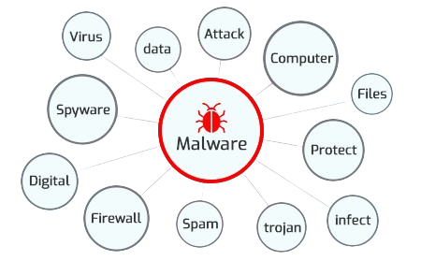
Who are the End Users ?
Malicious End Users:
Hackers and Cybercriminals: Use keyloggers to steal sensitive information, such as login credentials, credit card numbers, and personal data.
Cyber stalkers and Online Predators: Use keyloggers to monitor and track their victims' online activity.
Data Thieves: Use keyloggers to steal sensitive business data, intellectual property, or trade secrets.
Nation-state Actors: Use keyloggers as a tool for espionage and cyber warfare..

Slide 9

Solutions & its Values
Solutions:
Anti-Keylogger Software: Detects and removes keyloggers, providing real-time protection.
Encryption: Encrypts keystrokes, making them unreadable to keyloggers.
Secure Input Methods: Uses alternative input methods, such as on-screen keyboards.
Behavioral Detection: Identifies suspicious behavior, detecting keyloggers.5. Endpoint Security: Monitors endpoint activity, detecting keyloggers.
Values:
Protection of Sensitive Information: Prevents theft of sensitive data, such as passwords and credit card numbers.
Privacy: Ensures users' personal information remains confidential.
Security: Protects against cyber threats, including keyloggers.
Compliance: Helps organizations meet regulatory requirements, such as GDPR and HIPAA.
Peace of Mind: Provides users with confidence in their online security.
Incident Response: Enables quick response to keylogger attacks, minimizing damage.
Cost Savings: Reduces financial losses resulting from keylogger attacks.8. System Integrity: Preserves system integrity, preventing keyloggers from compromising security.

Slide 10

Modelling
Threat Modelling: Identifies potential threats, vulnerabilities, and attacks, including keyloggers.
Attack Trees: Visualizes the steps an attacker takes to achieve a goal, including keylogger deployment.
State Machines: Models the behavior of a keylogger, including its states, transitions, and actions.
Petri Nets: Represents the flow of data and control in a system, including keylogger interactions.
UML Diagrams: Uses Unified Modelling Language to model keylogger behavior, structure, and interactions.
Bayesian Networks: Models the probabilistic relationships between keylogger behavior, system variables, and security controls.
Agent-Based Modelling: Simulates keylogger behavior as an intelligent agent, interacting with the system and other agents.
+
These modelling techniques help in:
Understanding keylogger behavior: Identifying patterns, goals, and motivations.
Analyzing vulnerabilities: Identifying potential entry points and weaknesses.
Developing countermeasures: Designing effective detection, prevention, and response strategies.
Evaluating security controls: Assessing the effectiveness of security measures against keyloggers.
Predicting future threats: Anticipating new keylogger tactics, techniques, and procedures (TTPs).

Slide 11



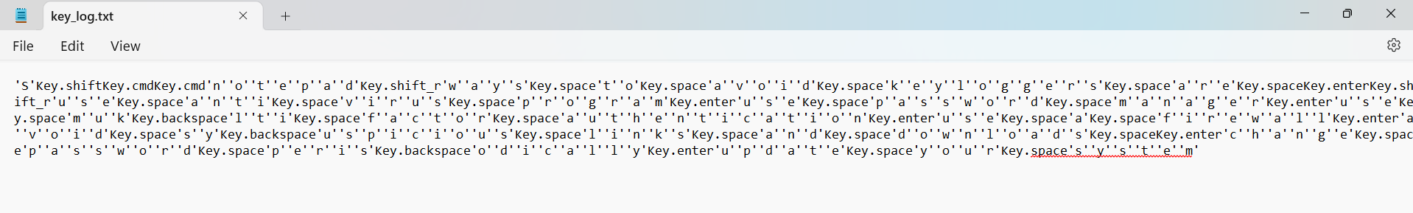

Result
Successfully implemented a keylogger that captures keystrokes and records them into both text and JSON files.
The GUI provided a user-friendly way to control the keylogger, making it accessible and easy to use.
Emphasized the ethical use keyloggers and the importance of implementing security measures to protect against malicious use.

